Slide 1

Hospital Readmission
Chintan, Gargi, Maryam and Ved
Mentored by: Shubham Bhhatt
Notes:
Line spacing + Page numbers

Slide 2








Process
OBJECTIVES
DATA MANAGEMENT
FEATURE ENGINEERING
DATA VISUALIZATION
PREDICTIVE MODELING
CONCLUSION
ANALYSIS

Slide 3
Objectives
To suggest optimal models to predict Diabetic patients’ readmission.
To uncover the underlying reasons behind the readmissions of diabetic patients and suggest ways to overcome them.

Slide 4
Concepts and Domains used
Data Mining: Extraction and simplification of large complex datasets to gain relevant insights and pattern recognition.
Machine Learning
KNN
Logistic Regression
Decision Tree
Random Forest

Slide 5
Factors
1
2
3
4
5
6
7
8
9
10
11
12
13
IDs
Gender
Readmission
Time in hospital
Diabetes Meds
Change in Meds
A1C result
Race
Weight
Medical Specialties
Drugs
No. of Meds
Glucose serum test result

Slide 6
Data Management
02

Slide 7
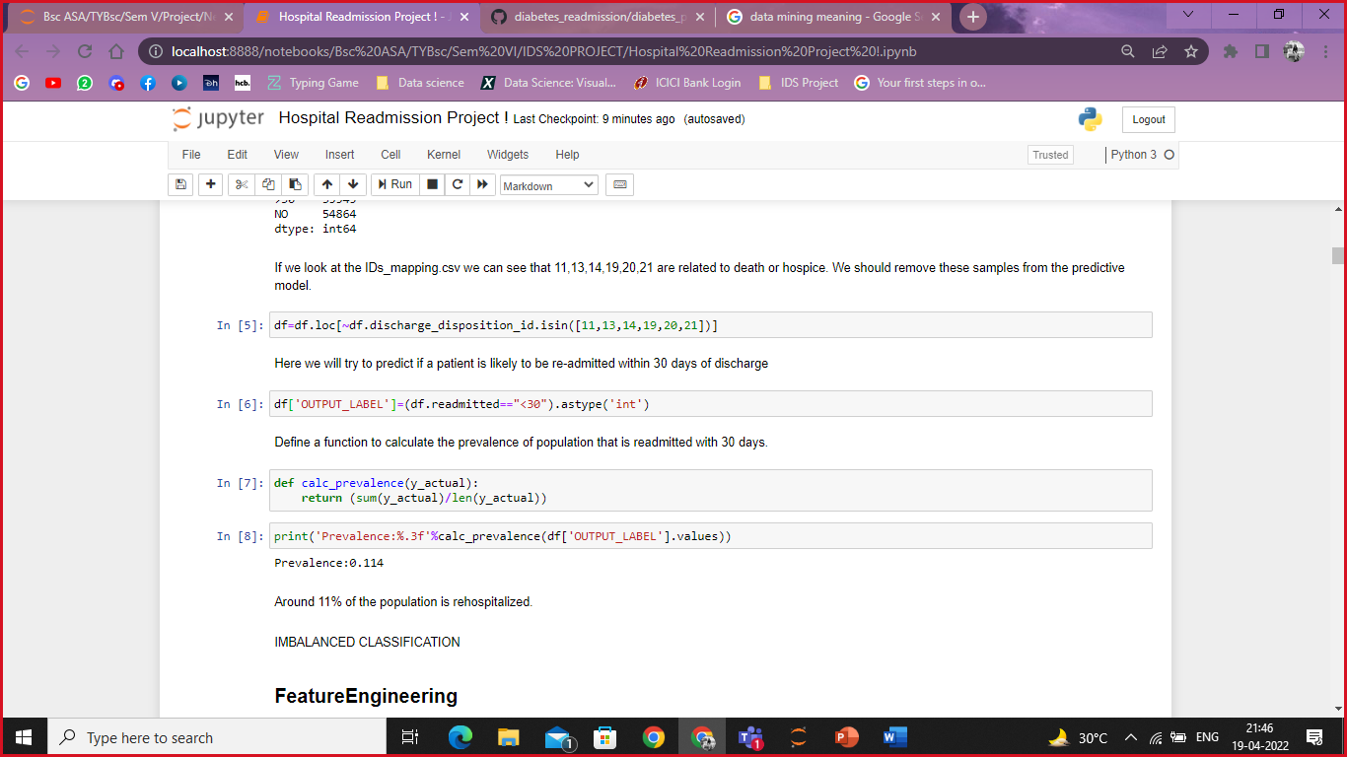
Data Management
02
Discharge Disposition: Death/Hospice
Irrelevant columns Dropped:
IDs
Diag 1, Diag 2, Diag 3,
Drugs: examide and citoglipton
Prevalence

Slide 8
Feature engineering
03

Slide 9

03
Numerical Features
New dataframes
Columns/features to use in the Models
Break down into 3 sections
time_in_hospital
num_lab_procedures
num_procedures
num_medications
number_outpatient
number_emergency
number_inpatient
number_diagnoses
Categorical Features
Race
Gender
A1Cresult
Glucose serum test
Drugs, diabetes Meds
Change of Meds
Medical specialty
Payer Code
Total number of features: 143
Numerical features: 8
Categorical Features: 133
Extra features: 2
Extra Features
Age
Weight

Slide 10
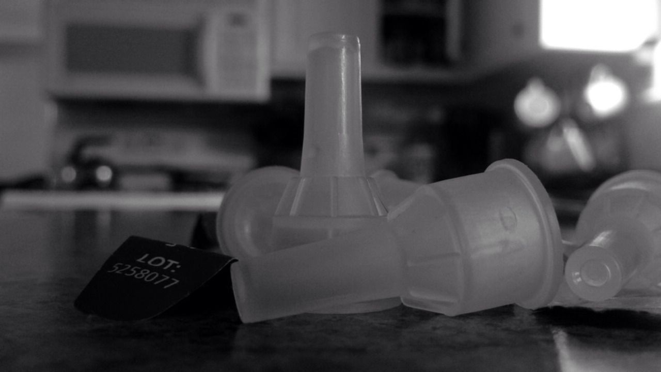
03
Splitting the Data: Train: 70%
Validation: 15%
Test: 15%
Imbalanced Data: Sub-sample the more dominant class: use a random subset of the negatives
Standard Scale: Age
Weight (Knn and Logistic Reg)

Slide 11
Data Visualization
04

Slide 12
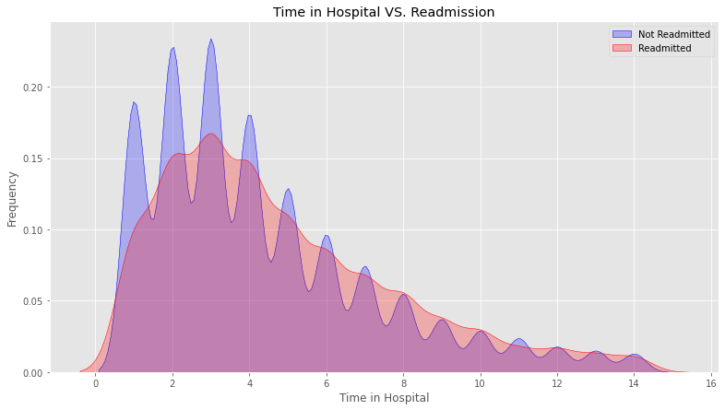
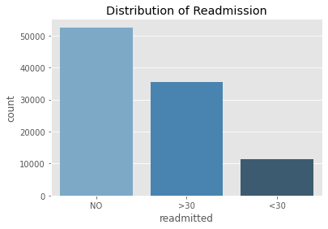
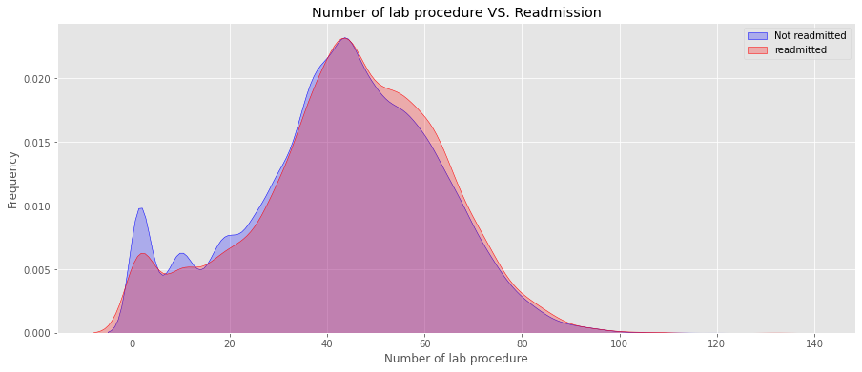

Slide 13
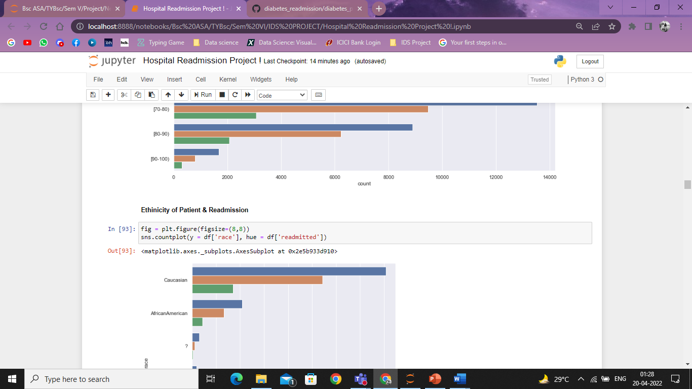
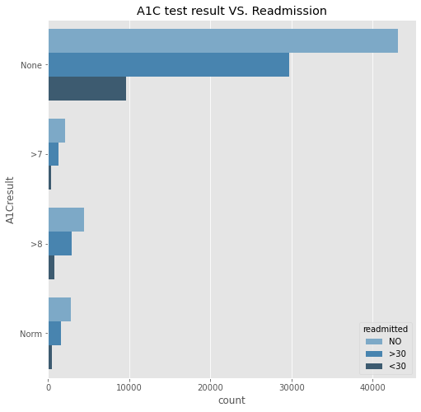
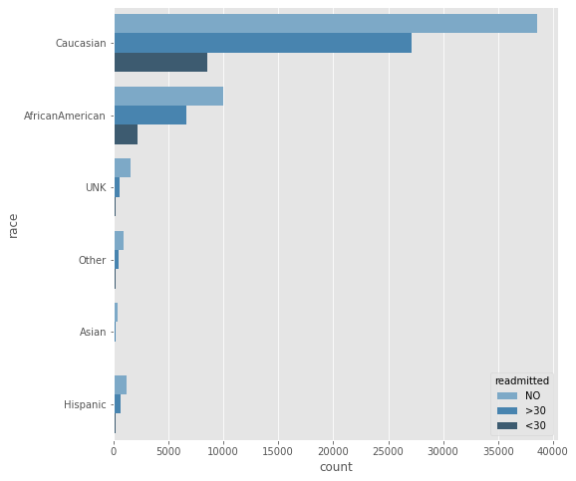
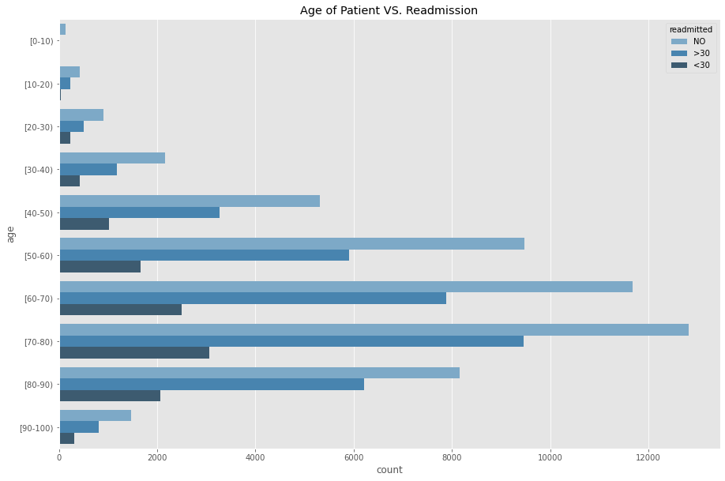
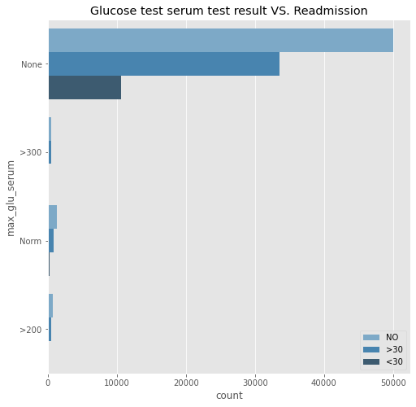

Slide 14
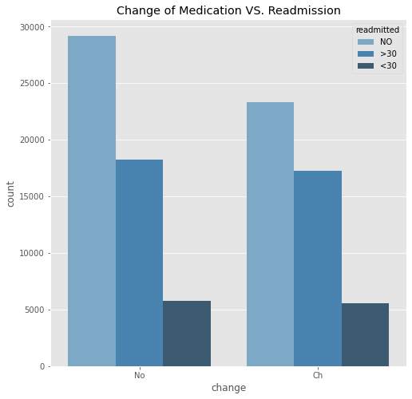
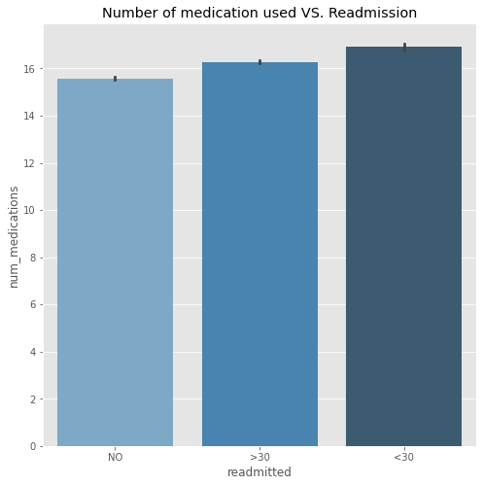
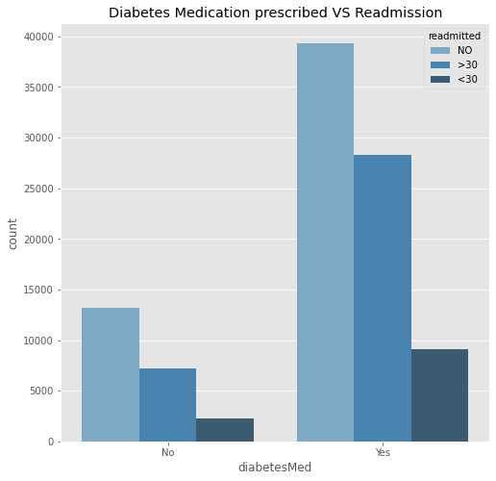
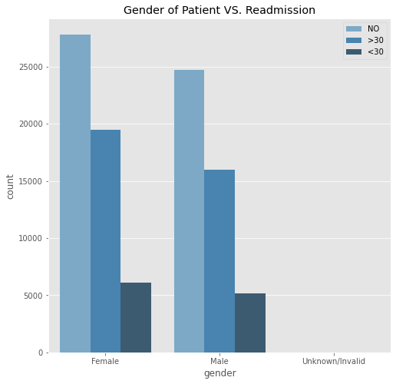

Slide 15
Predictive Modeling
05

Slide 16
Logistic Regression
05
What is Logistic Regression?
Logistic regression is used to predict a binary outcome, such as yes or no, based on prior observations of a data set.
Dependent Variable: Readmitted within 30 days or not
yes: 1
No: 0

Slide 17
KNN
05
The number of nearest neighbours considered for a new unknown variable that has to be predicted or classified is denoted by the symbol ‘K’.
There are various methods for calculating this distance, of which the most commonly known methods are — Euclidian, Manhattan (for continuous) and Hamming distance (for categorical).

Slide 18
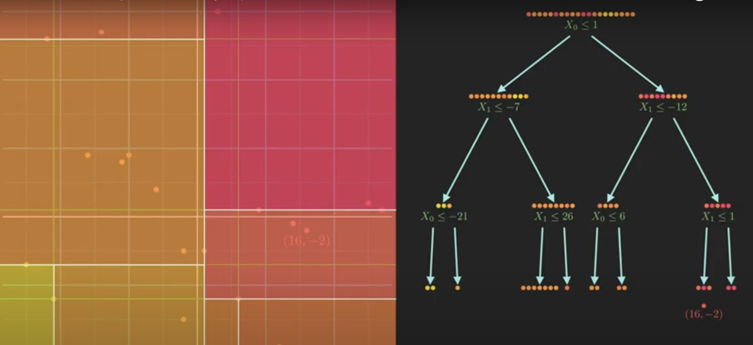
Decision tree
05
What is Decision Tree?
Why did we use it?
Parts of the Tree
Defining Impurity

Slide 19
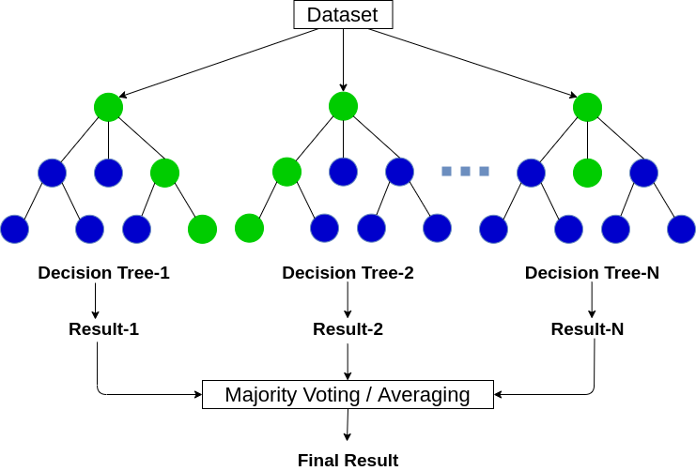
Random Forest
05
What is Random Forest?
Why did we use it?

Slide 20
Conclusion
06

Slide 21
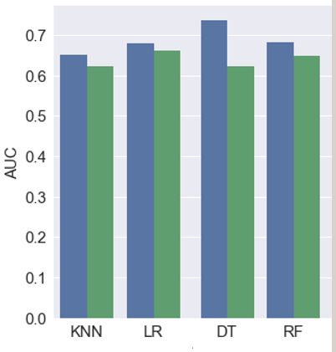
Comparing the models
06
Knn:
AUC:0.624
Rmse score:0.575
prevalence:0.117
Logistic Regression:
AUC:0.661
Rmse score:0.590
precision:0.183
prevalence:0.117
Decision Tree:
AUC:0.586
Rmse score:0.554
prevalence:0.117
Random Forest:
AUC:0.657
Rmse score:0.628
prevalence:0.117

Slide 22
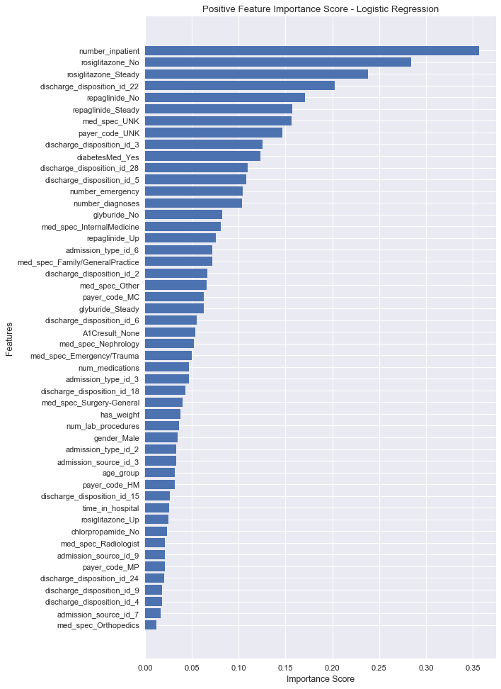
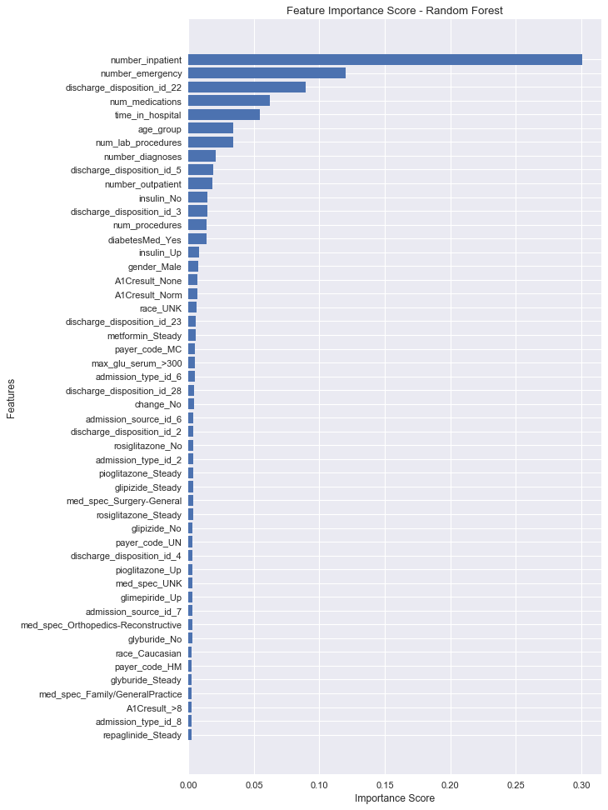
Analysis
07

Slide 23
Bibliography
08
We referred to multiple Kaggle projects and for conceptual base we looked at StatQuest videos.

Slide 24
Acknowledgement
9
This project would not have been possible without the guidance of our IDS professor, Shubham Sir
We would like to thank NMIMS deemed to be university for providing us with this opportunity.

Slide 25
Team
Chintan Mehta
LinkedIn
75252019016
Gargi Rajadnya
LinkedIn
75252019019
Maryam Ahmad
LinkedIn
75252019003
Ved Barve
LinkedIn
75252019005

Slide 26
Thank You

